Slide 1
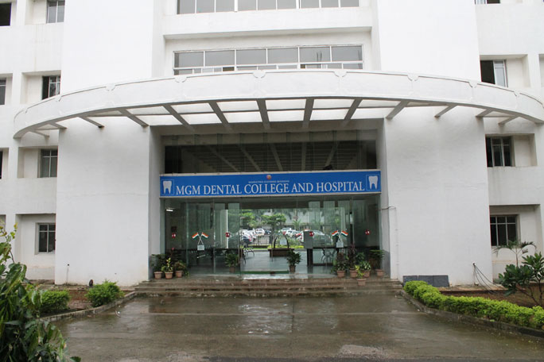
MGM DENTAL COLLEGE & HOSPITAL
Accredited by NAAC with A++ Grade
Department Of Prosthodontics And Crown And Bridge
CDE Program
“Multidisciplinary approach in Clinical Geriatric Dentistry”
22nd August 2023

Slide 2
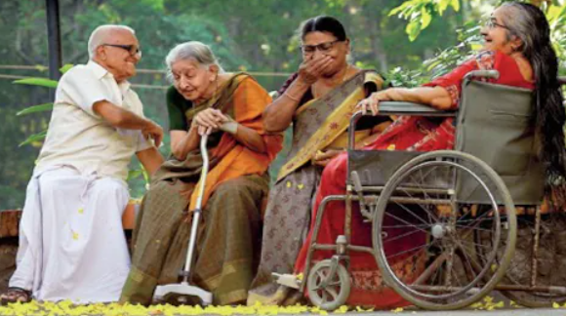
Multidisciplinary approach in Clinical Geriatric Dentistry”
Geriatric dentistry is the delivery of dental care to older adults involving diagnosis, prevention, management and treatment of problems associated with age related diseases. Older adults are more susceptible to oral conditions or diseases due to an increase in chronic conditions and physical/mental disabilities. Thus, the elderly form a distinct group in terms of provision of care. In many nations, Geriatric dentistry falls under the ‘Special needs dentistry’ specialty because often age related problems and medication can make oral health disease and conditions much more serious and complicated to treat. As a result, they require specialized and individualized treatment and considerations.

Slide 3
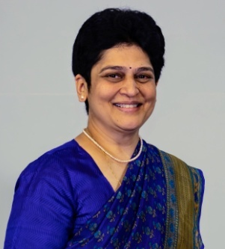
GUEST SPEAKERS
Dr. Smita Athavale
Dr. Smita Athavale has completed BDS & MDS Prosthodontics from Nair Dental College, Mumbai, India.
She has 22 years of experience as Professor, P.G. Guide & Ph.D. teacher in Dr.D.Y. Patil dental college, Pune, India. She has her private practice restricted to Prosthodontics - "Dentofacial Rehab" - in Pune.
She is a Consultant Maxillofacial Prosthodontist, Geriatric Dentist & founder member of cleft care center in Deenanath Mangeshkar Hospital & research centre, Pune.
She is Member of Editorial board – JIPS. She is a Founder & EC member of IPS Pune branch.
She is Former Joint Secretary of Geriatric society of India - Pune chapter.
She is a member of Geriatric Board - Federation of special care dentistry.
She is a member of IDA, IPS,GSI, ISOI, FSCD & ISPRP.
She has completed a certification course in 'Geriatric medicine' conducted by Geriatric society of India.
She has had Scientific papers published in national & international journals & has been a guest / key note speaker at national & international conferences.

Slide 4
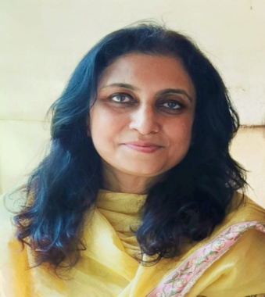
Dr. Archana Dhusia
UG and PG in oral and maxillofacial surgery from Nair hospital dental college.
She has 28 yrs of experience and is currently heading the Dept. Of Dentistry and Maxillofacial Surgery at HBT municipal medical college and Dr.R.N.Cooper general hospital, Mumbai.
She has many accolades to her name since her undergraduate days.
She has chaired many scientific sessions and deliberations at various conferences
Reviewer of Indian journal of Anaesthesia, journal of dental specialities and has many publications in national and international journals.
Conducted workshops on various topics like Minor Oral Surgery and suturing techniques for IDA, Botox workshop face 16 for AOMSI, MSC.
Faculty at the national cadaver dissection workshop (head and neck) at MGM dental college
EC member- DDF committee of HBT medical college

Slide 5
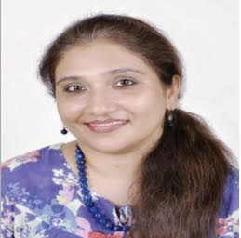
Dr. Asha Narde
She has completed her graduation from Nair Hospital Dental College and her post-graduation from K.L.E.S Dental College, Belgaum.
She has acquired training in Advanced Endodontics and use of Dental Microscope for the same internationally under reputed endodontists.
She is a Consultant at the Centre For Advanced Dentistry at Breach Candy Hospital Trust, Mumbai as an Endodontist since 2009.
She was the recipient of The Special Jury Award for The Outstanding Clinician by Famdent Excellency in Dentistry Awards in 2022.
Her focus is on treatment, retreatment and rehabilitation of the decayed and worn dentition in young and geriatric patients by performing endodontic, restorative and preventive therapy efficiently and rapidly with predictable results.
She has been lecturing extensively to create awareness on oral health needs in the geriatric population.

Slide 6
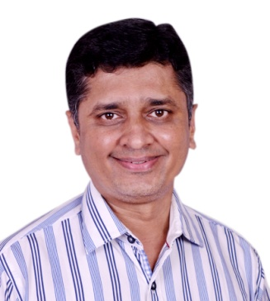
Dr. Paresh Gandhi
Dr Paresh Gandhi, BDS & MDS from Mumbai University with Gold Medals at both levels.
Consultant Prosthodontist & Implantologist, practising for last 25 years.
Completed Masters in Dental Lasers from University of Vienna, Austria in 2009.
Passion is Prosthodontic Planning in Implantology, with special emphasis on Full Mouth Rehab and Lasers in Practice.
Delivered several National and International Keynote addresses and as guest speaker.
Actively conducts workshops on FPD and IMPLANTS.
His recent passion being Soft Skills training for Dentists which is has immensely helped clinicians in their private practice.
Past President of Rotary Club and was Director for several years. Past President of Indian Prosthodontic Society, Pune .
Member of Reviewer Committee, JIPS.
He’s also a Consultant Prosthodontist And Implantologist at Poona Hospital, Pune and runs his private practice over 2 decades.

Slide 7
SCHEDULE
TIME | TOPIC | SPEAKER
10.15am to 10.30am | Inaugration and Welcome speech
10.30 am to 11.15am | Introduction to geriatric dentistry & prosthodontics | Dr. Smita Athavale
11.15am to 12.00am | Geriatric dentistry - an oral surgeon's perspective | Dr. Archana Dhusia
12.00pm to 1.00pm | Lunch
1.00pm to 1.45pm | Restorative and endodontic considerations in geriatric dentistry | Dr Asha Narde
1.45pm to 2.30pm | Geriatric Implantology - Protocols And Pathways | Dr. Paresh Gandhi
2.30pm to 2.45pm | Felicitation of the speakers

Slide 8
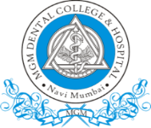
MGM Dental College & Hospital
Address: Plot No -01, Sector – 01,
Kamothe, Navi Mumbai
Pin code: 410209
Contact: 022 27436604
Email: mgmdcbh@mgmmumbai.ac.in
Web: www.mgmmumbai.ac.in/dentalcollege
Venue:
MGMDCH - Kamothe,
Navi Mumbai
Date: 22nd August, 2023
Time: 10am – 3pm.
Contact:
Workshop Coordinators:
Dr. Prachiti Terni
07977183630
Dr. Disha Visaria
09664872575

